Slide 1
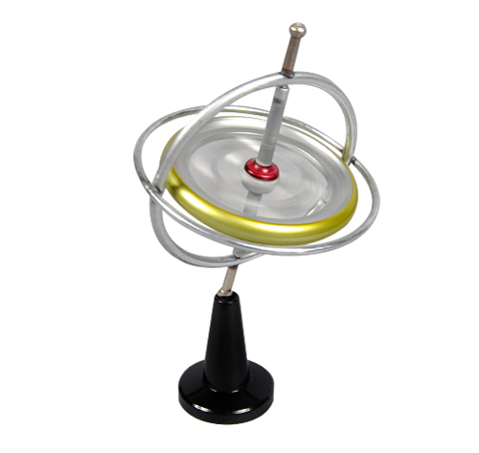
Gyroscope 陀螺儀
Group 23 吳由由 高為勳

Slide 2

INITIAAL CONDITION
假設陀螺儀自轉初 $ω$
假設質量為 M
假設陀螺儀自轉轉速非常快，
自轉角頻率遠大於進動角頻率

Slide 3
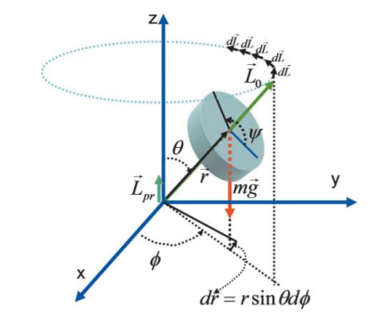
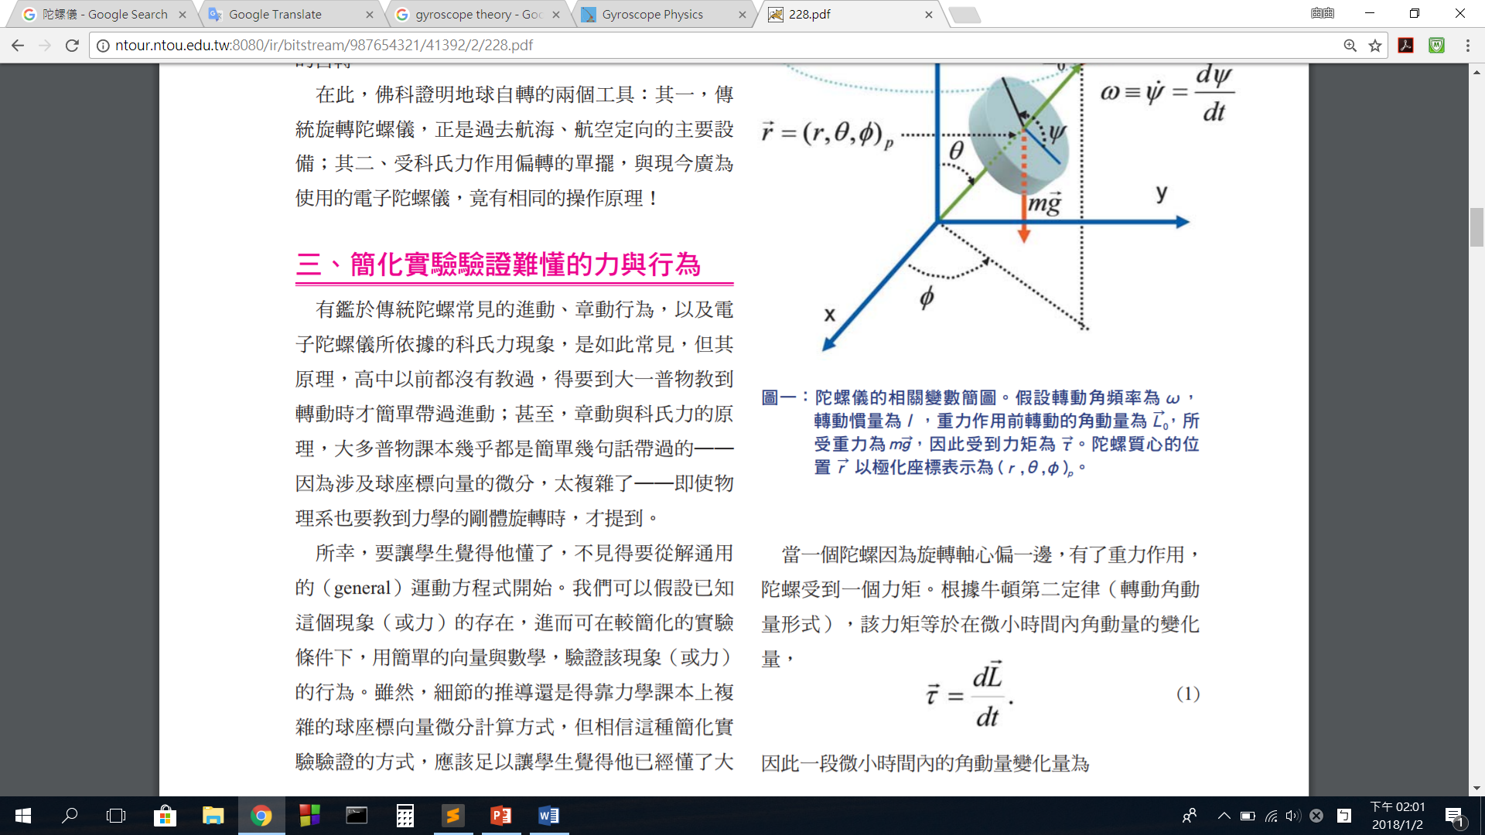
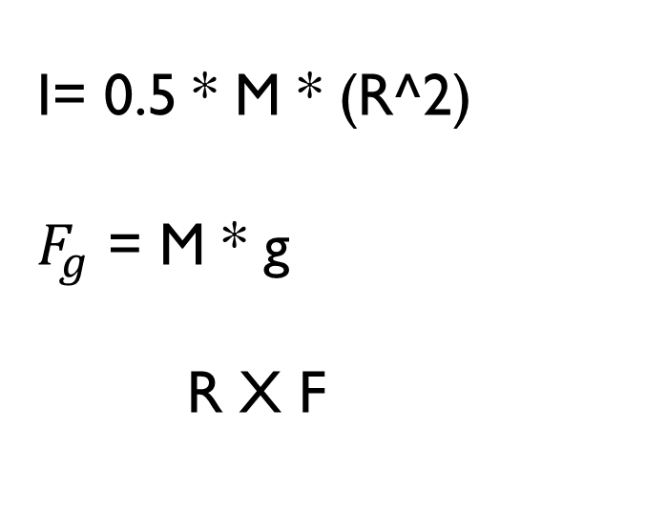
Physics laws
I= 0.5 * M * (R^2)
$F_{g}$ = M * g
R X F

Slide 4
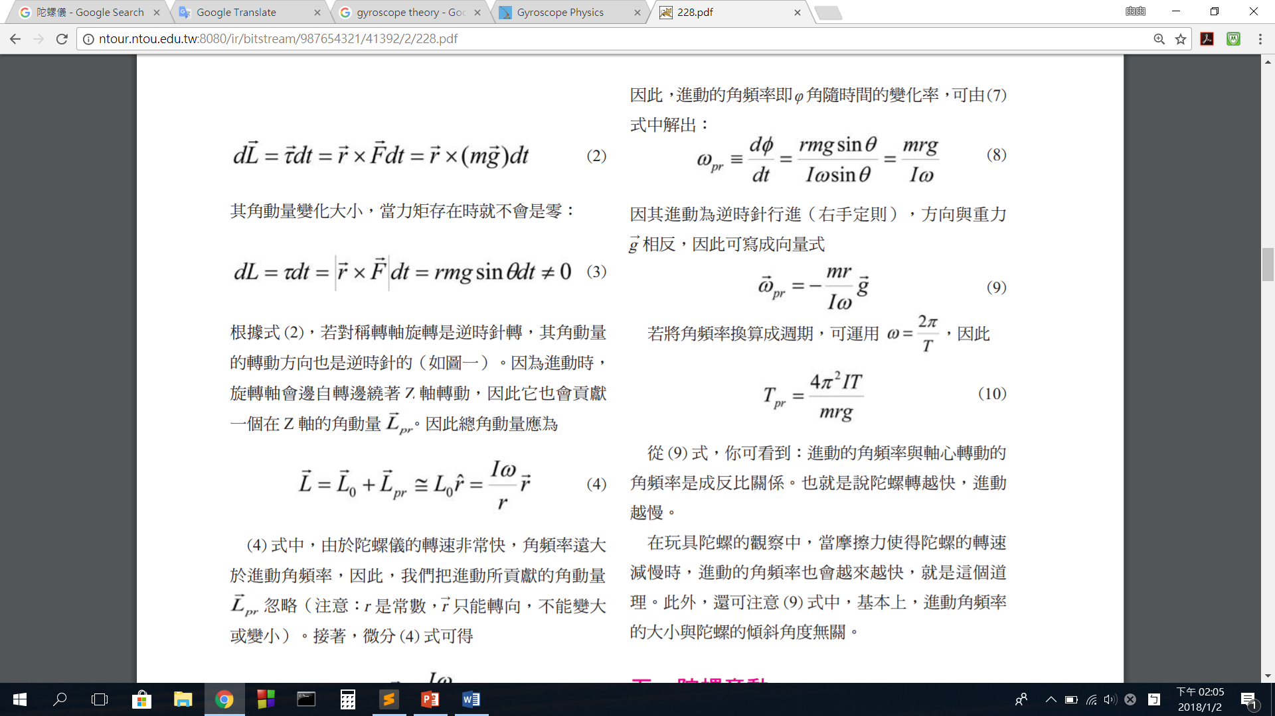
Physics laws

Slide 5
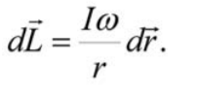
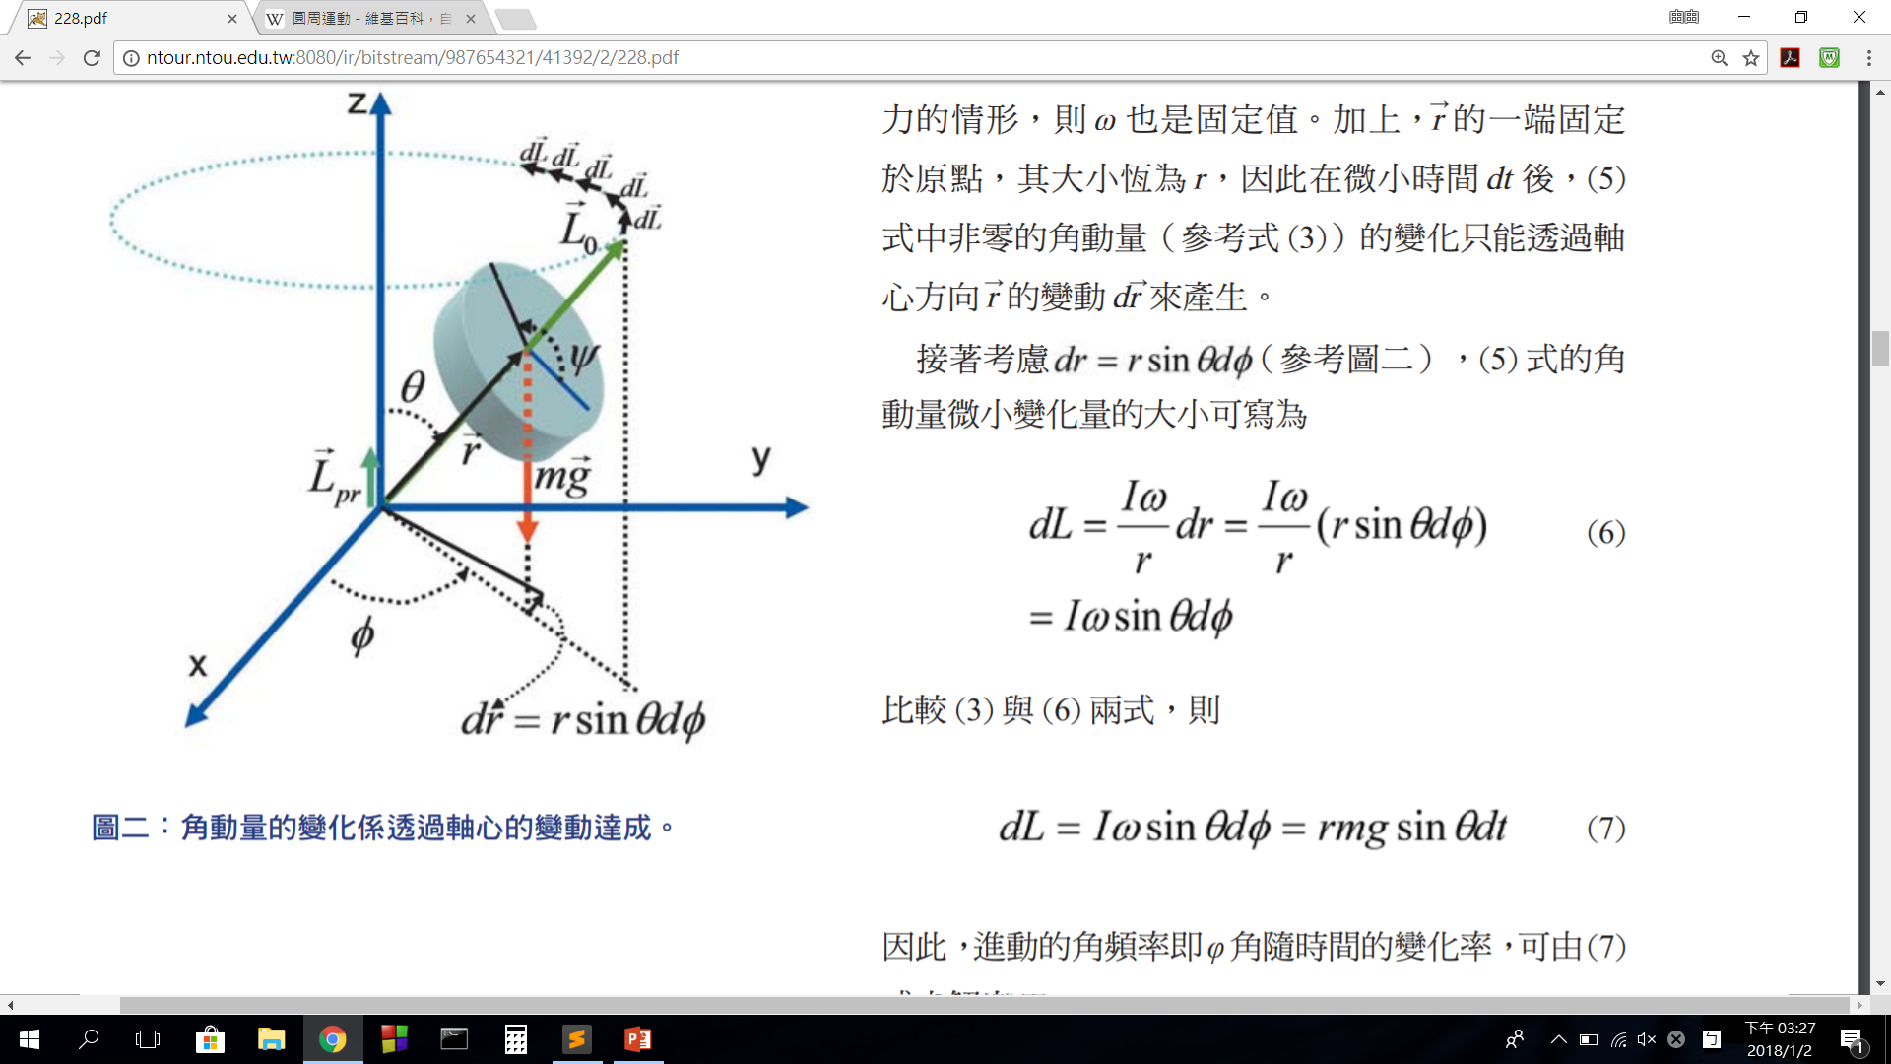
Physics laws

Slide 6
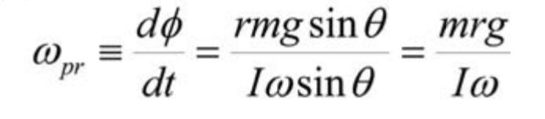
Physics laws

Slide 7
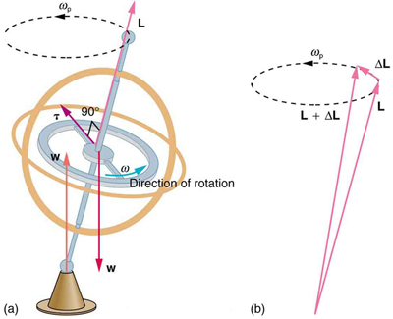
How it work ?

Slide 8
CONCLUSION
進動的角頻率與軸心轉動的 角頻率是成反比關係
陀螺轉越快，進動越慢
進動角頻率的大小與陀螺的傾斜角度無關

Slide 9
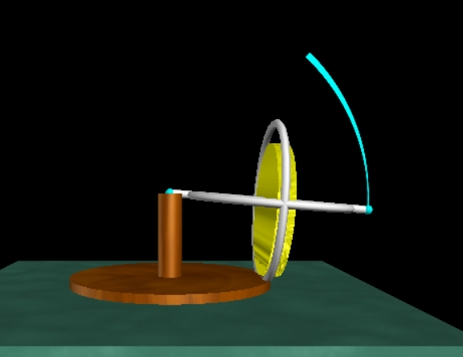
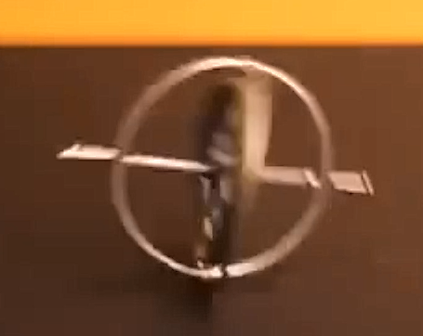
Demo – no spinning

Slide 10
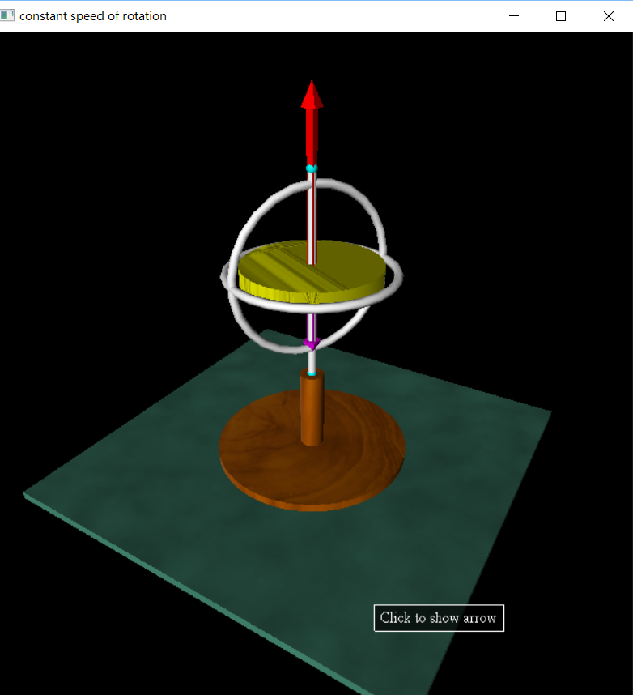
Demo – 90 degree

Slide 11
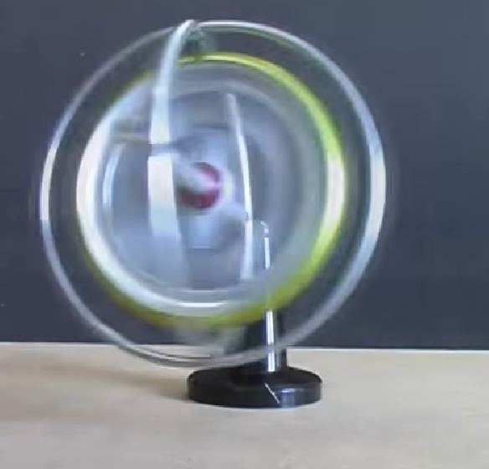
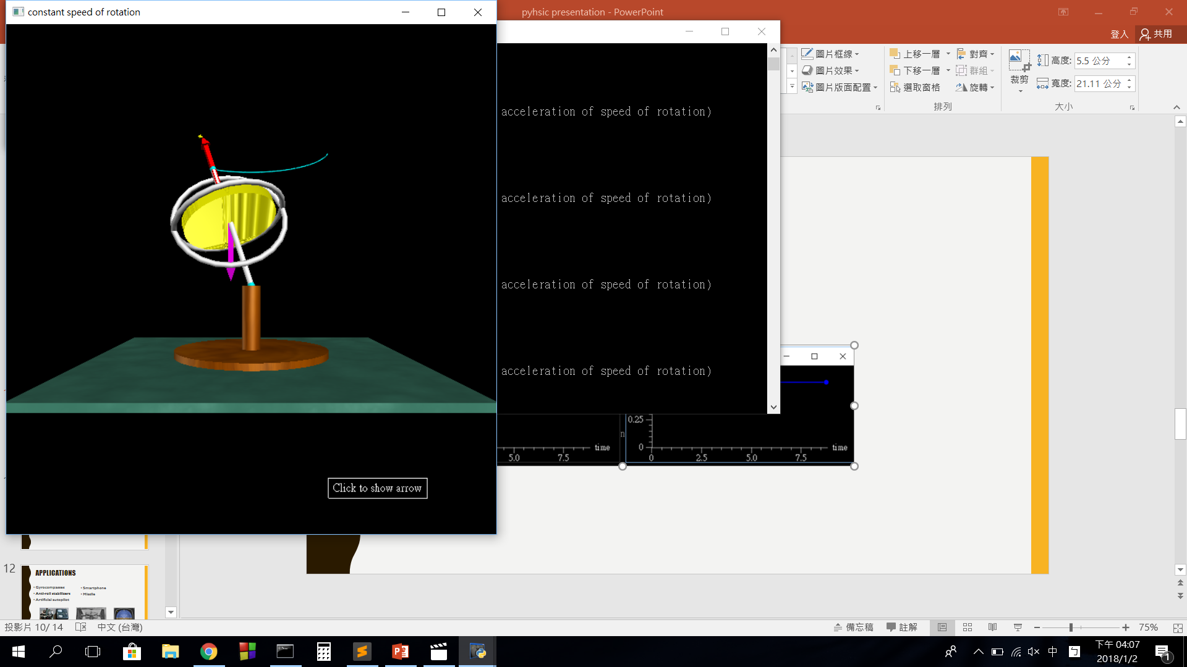
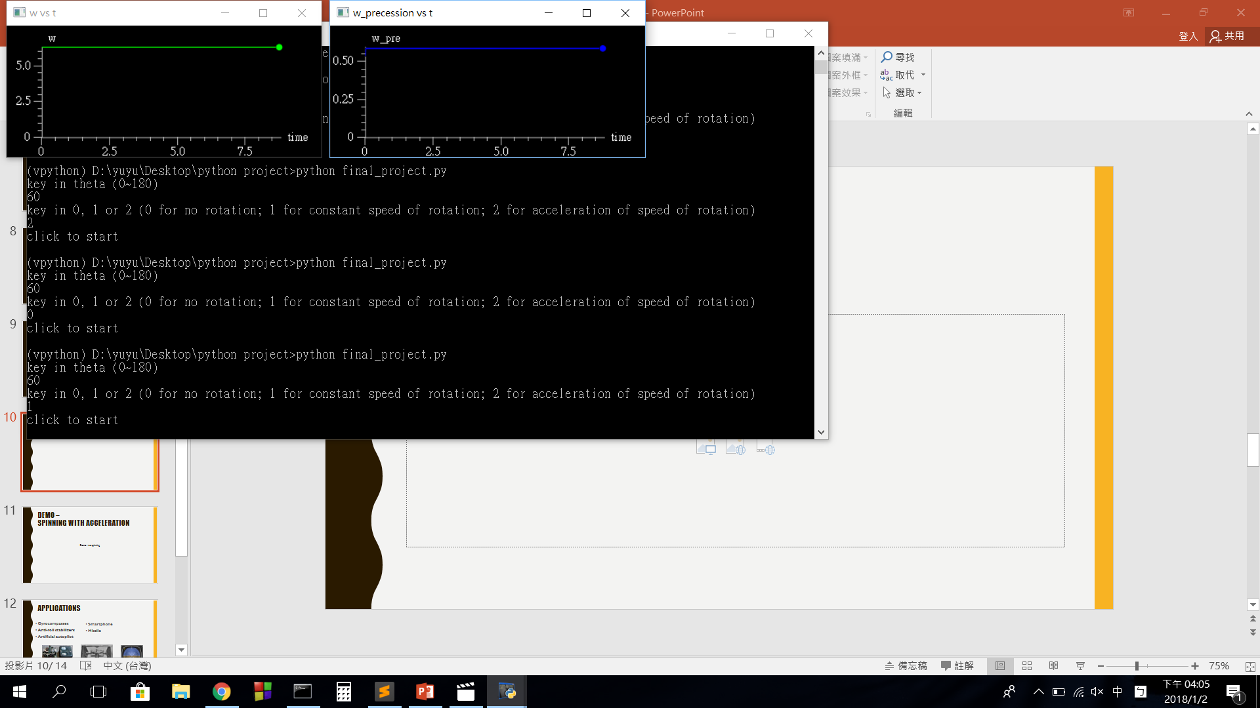
Demo – spinning

Slide 12
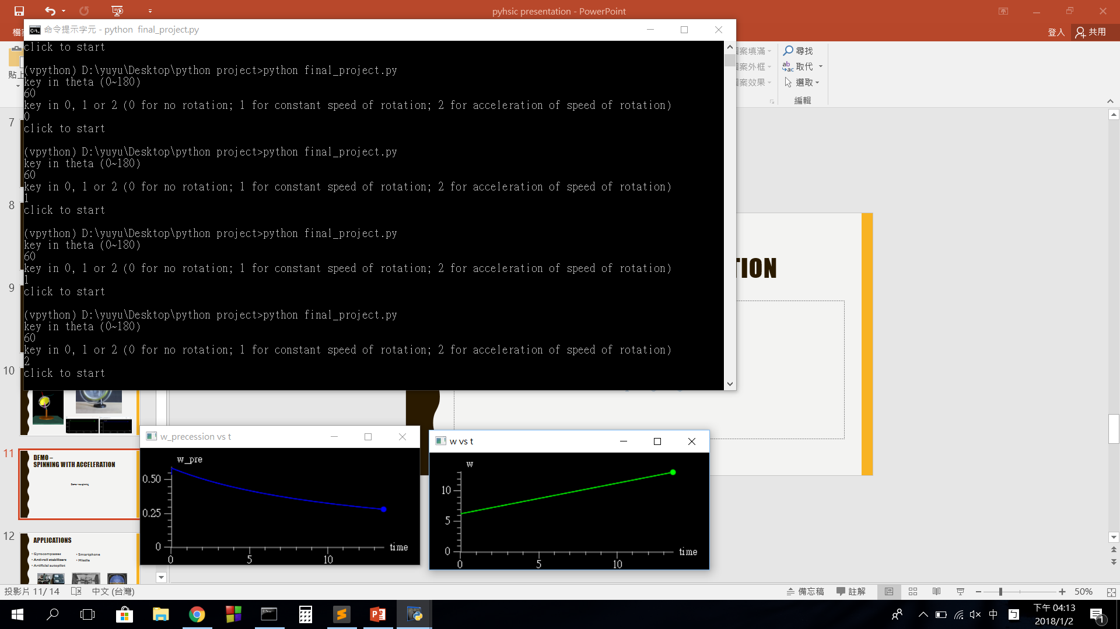
Demo – spinning with acceleration
Demo - no spinning

Slide 13
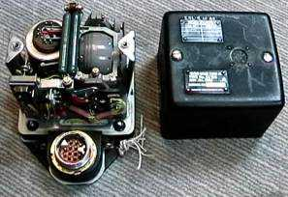
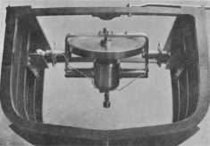
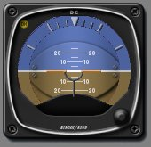
applications
Gyrocompasses
Anti-roll stabilizers
Artificial autopilot
Smartphone
Missile

Slide 14
references
1.搞定陀螺儀 從傳統到現代 物理雙月刊 36卷03期
ntour.ntou.edu.tw:8080/ir/bitstream/987654321/41392/2/228.pdf
2.陀螺儀 - 維基百科
https://zh.wikipedia.org/wiki/%E9%99%80%E8%9E%BA%E5%84%80
3.陀螺儀
https://scitechvista.nat.gov.tw/context/file/pdf/89a2f1d4e6855cb4e09ff5f3bc938dc96ca03240c0011c0a8e87592f8db1f017.htm
4. How Gyroscopes Work
https://science.howstuffworks.com/gyroscope.htm
5. Gyroscope Physics
https://www.real-world-physics-problems.com/gyroscope-physics.html

Slide 15
Thank you for listening

